Slide 1
Method | Price | Sensitivity | Size | Power
Silicone Elastomer | Magnetometer - $9.99 Si - $0.01 Magnet - $0.10 | 1 mN resolution Range goes up to at least 2.6 N | 3mm x 3mm x 0.8mm | 100uW to 10mW

Slide 2
Introduction
The differential pressure sensor has shown promise, however 2 main issues
High cost compared to other sensor techniques ($20/sensor)
Potential issues down the line with sedimentation or corrosion
Magnetometer-based force sensor solves these issues
Low cost ($1.85/sensor)
No sedimentation issues
Ultra-low power consumption (100uW to 10mW)
High resolution (1 mN)

Slide 3

Magnetic Pressure Sensor
Urine Stream
Neodymium Magnet
F_{x}
Silicon Elastomer
F_{z}
F_{y}
Neodymium Magnet
Deformation
d₁
Silicon Elastomer
d₂
Magnetometer
Magnetometer
Force from urine stream causes shear and normal stress on elastomer, bringing the magnet closer/farther from the magnetometer. Magnetic field changes then corresponds to applied force

Slide 4
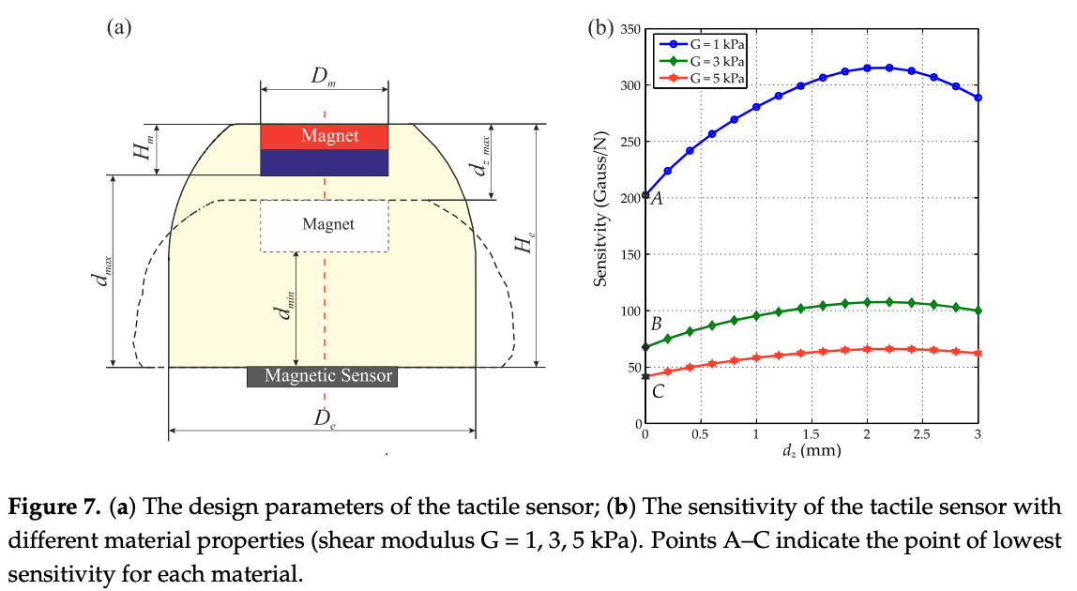

Slide 5
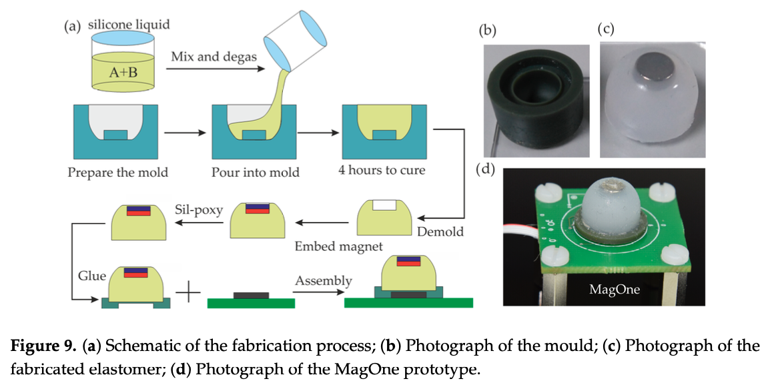
Manufacturing Process
3D Print Mold for Elastomer
Pour Elastomer (Si) into Mold and Cure
Attach the neodymium magnet to the indentation in the elastomer mold using Sil-poxy
Connect assembly to PCB using adhesives

Slide 6
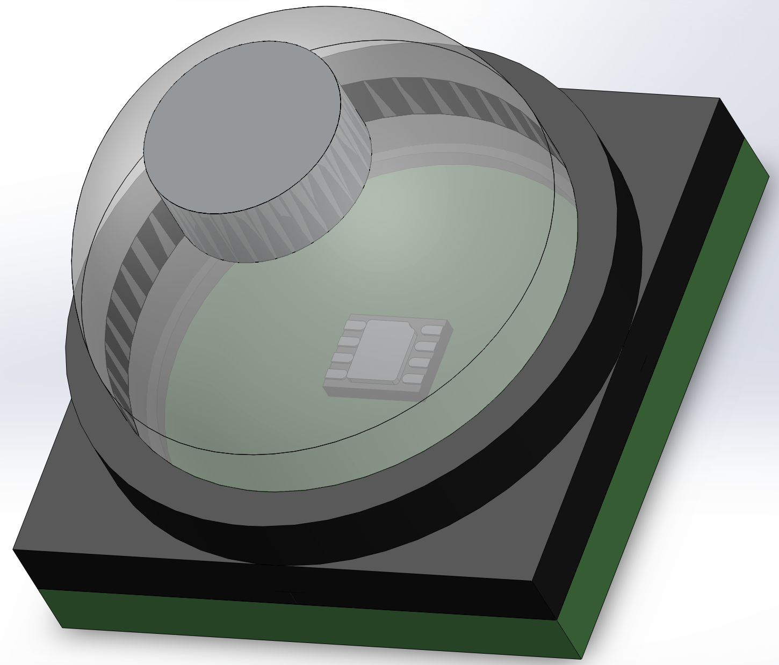
CAD Model
Neodymium Magnet
Silicon Elastomer
PCB Waterproof Casing
11.22mm
Magnetometer Sensor
PCB
14mm
14mm

Slide 7
Further Considerations
May be difficult to manufacture, since Si elastomer must be prepared manually
Elastomer can deform over time due to creep effects, however the geometry of the elastomer and placement of the magnet at the top mitigates this
Lots of testing required and many different configurations (ie. Elastomer material, elastomer geometry, magnet size, magnetometer)
Tilting of magnet can cause inaccuracies – can be mitigated with IMU MEMS sensor

Slide 8
Prototype
To test the viability of this solution and compare performance with other sensor prototypes, I propose assembling a magnetic elastomer force sensor and testing the accuracy in a controlled environment
The test will be:
Using a water bottle, pour water onto the elastomer sensor using 2 test variations: 1) constant rate (simulating healthy) and 2) sputtering (simulating BPH)
Record the magnetometer data locally, either directly to the computer or on an SD card connected to the microcontroller
Record the true flow rate using the mass scale
Using the LSTM model from Mikayla’s rig, fit the data
Test the LSTM results

Slide 9
Prototype Materials
Item | Cost
Neodymium Magnets (5mm x 2mm) | $6.99
Magnetometer | $1.85
Microcontroller | Available in lab
Silicon | $42.99 (2lbs)
Sil-poxy | $5.98
Silicon Releasing Agent | $16.99
3D-print | Available in lab
Total Cost of Materials: $74.80

